Slide 1
Swadhyay!
“Be curious, Be patient, not judgmental”
A platform promoting self- learning

Slide 2
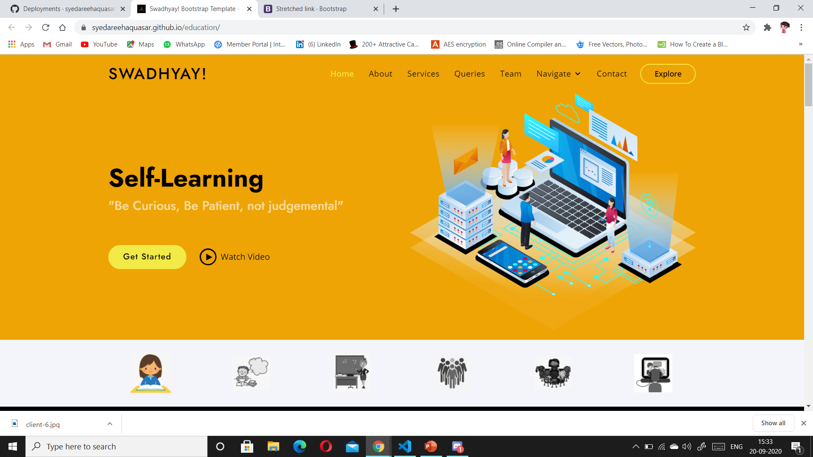

Slide 3
Objective
A collaborative effort initiated to promoted self-paced learning. Dedicated, focused and passionate to collaborate together to develop quality products. Intended to realize that collaboration is our strongest asset!
We are a team of 3 members: dedicated, focused and passionate to bring about reforms and think differently. The main object to develop SWADHYAY! is to combine and complement the different perspective and ideas collaboratively to promote e-learning.
collaborate and succeed.
Grow as a community.
be curious, be patient not judgemental.

Slide 4
Highlights
NOTE-A-BOARD
A practical combination of creating your personalised notes.
Search and Solve!
A service which enables to find the relevant content for the items that you search and simplifies your life!
WhatBot!!
WhatBot is your friend which will help you to cross the hurdles coming up on your way.
Contact the counsellor
A scripting service which will lead to contact the counsellor for the appropriate guidance and mentorship.

Slide 5
Technology Stalk
HTML
CSS
JavaScript
Flask
Python
Python advance Modules

Slide 6
Future Scope
More resources and features.
Database.
More interactive interface.
Adding relaxing exercises and games.

Slide 7
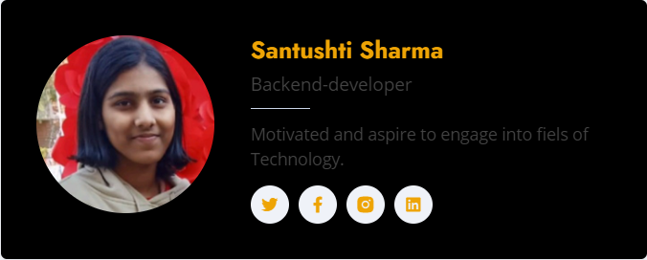
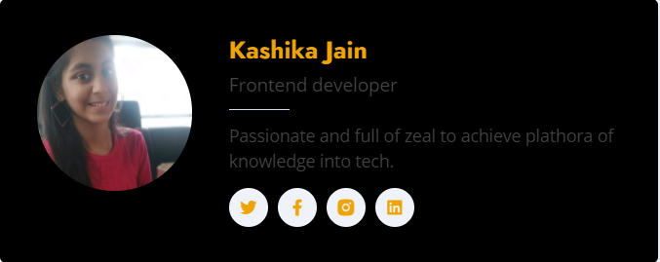
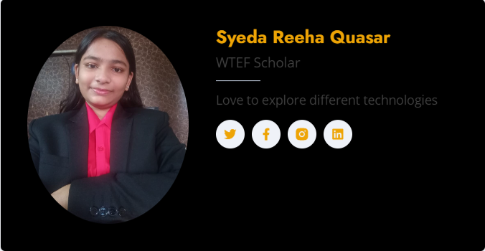
TEAM Name - SRK

